Slide 1
Introduction to Java Programming Language
Contents:-
Inheritance and its types
Method overriding
final keyword, super keyword
Abstract classes and abstract methods
Interfaces
1

Slide 2
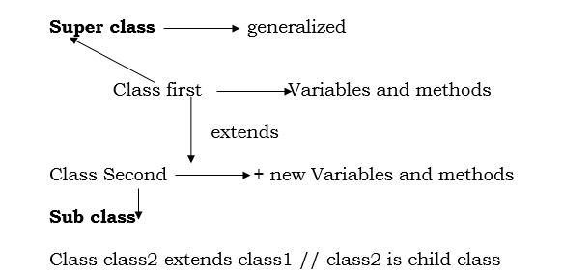
Inheritance:
Inheritance is the mechanism of creating subclass while extending the features of super class and adding additional features into it is known as Inheritance.
The keyword ‘extends’ is used for inheriting the property of super class to subclasses.
Inheritance represents the IS-A relationship which is also known as a parent-child relationship.
Inheritance provides reusability, extendibility and data hiding.
The main disadvantage of Inheritance is that two classes are tightly coupled.
Java does not support multiple Inheritance.
Code-1:

Slide 3
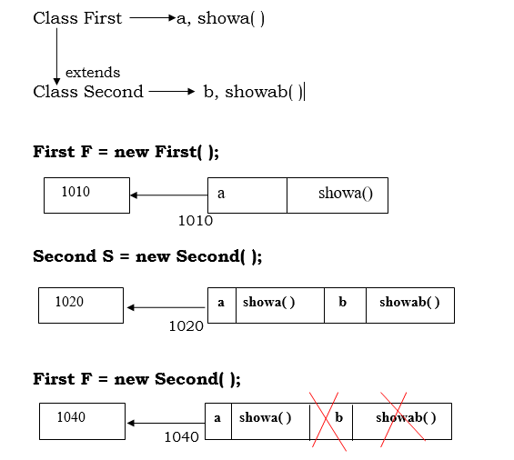
Inheritance:
Member Access in Inheritance:
The Private members of super class are never inherited to subclass.
The object reference variable of super class can refer objects of subclass.

Slide 4
Inheritance:
Note: The object reference variable of super class can refer the object of subclass. But in that object it refers to those members that are inherited from super class to subclass. The members defined in subclass are not referred
Code-2:
Using “super” keyword: Super keyword can only be used in subclass.
1.To call the constructor of super class
2.To refer members inherited from super class.
1. To call the constructor of super class:
Code-3:
2. To refer members inherited from super class: When super class and subclass hold the member of same name, the object reference variable of subclass can refer the member defined in subclass and not the inherited member. To refer inherited member, we need to use “super” keyword with dot (.) operator.

Slide 5
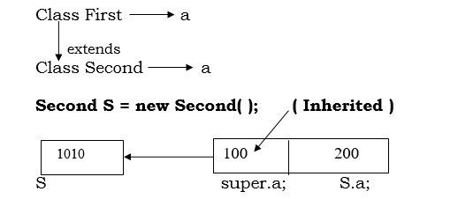
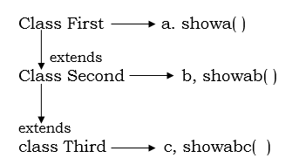
Inheritance:
Code-4:
Multilevel Inheritance:
Code-5:

Slide 6
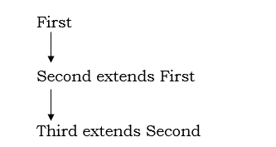
Inheritance:
How the constructors gets called in Multilevel hierarchy:
In Multilevel hierarchy we try to create object of any class, the constructors are loaded in memory from class at higher level class to lower level.
Code-6:

Slide 7
Final Keyword
final keyword:
Final variables are constants of Java
Final methods cannot be overridden
Final class cannot be inheritable
We cannot reassign
We cannot change the value of final variable.
The final keyword in java is used to restrict the user. The java final keyword can be used in many context. Final can be used with:
---variable
---method
---class
The final keyword can be applied with the variables, the value of the variable can not be modified. If the final applied with method then that method can not be overridden in sub class. If final is applied with class then that class can not be inherited.
Code-7:
Code-8:
Code-9:

Slide 8
Method Overriding:
Method Overriding:
Method having same name and same method signature is called as method overriding.
Method overriding is used to provide the specific implementation of a method which is already provided by its superclass.
Method overriding is used to achieve runtime polymorphism
Code-10:

Slide 9
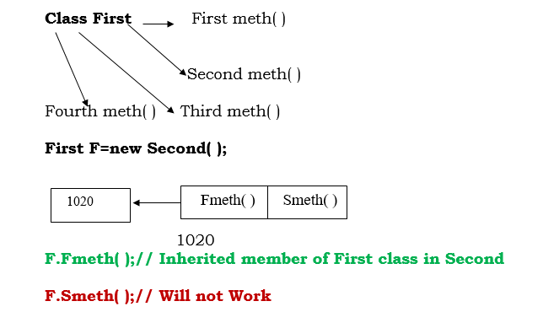
Runtime Polymorphism:
D.M.D(Dynamic Method Dispatch) Or Runtime polymorphism

Slide 10
Inheritance:
D.M.D(Dynamic Method Dispatch) Or Runtime polymorphism
F=new Second( );
F.meth( );// Meth method of Second class
F=new Third( );
F.meth( );// Meth method of Third class
F=new Fourth( );
F.meth( );// Meth method of Fourth class
The object reference variable of super class can refer the object of subclass. But in that object it refers to those members that have been inherited from super class to subclass.
In case of method overriding, the object reference variable of super class refers method defined in subclass. Hence by creating multiple subclasses and overriding its methods; we can make the object reference variable of super class to refer overridden methods in subclasses. This is known as runtime polymorphism provided by java and is known as D.M.D.
Code-11:

Slide 11
Abstract Classes:
Abstract Classes:
We can write a method without body in Java. Such method is known as abstract method. Such method is incomplete method and when any class contains such method it also becomes as incomplete class and should be
declared as an abstract class.
Abstract class cannot be instantiated. We cannot create objects of abstract class.
They are purely used for Inheritance purpose to achieve D.M.D. When any class extends an abstract class, it should provide body to all the methods of abstract class otherwise it should be declared as an abstract class.
The abstract class may contain concrete method and constructor.
Without method overriding we cannot achieve D.M.D.

Slide 12
Inheritance:
Abstract Classes:
We can have constructor in abstract class and can be invoked by the constructor of subclass through “super” keyword to achieve Inheritance and D.M.D. i.e. Subclass constructor can call the Super class constructor through ”super” keyword.
We can create object reference variable of abstract class to refer the object of subclass.
The extending classes should provide bodies to all the abstract methods of super class otherwise it should also be declared as abstract.
Code-12:
DMD Using abstract classes.
Code-13:

Slide 13
Interfaces:
Interface:
Interfaces are as good as classes.
All methods in Interface are abstract
Interface cannot have concrete methods
It is used for multiple Inheritance to achieve D.M.D
No constructor is used in Interfaces because super keyword is not used.
We cannot create object of Interfaces but we can create object reference
variable of Interfaces.
Method declared in Interface are always public so that we can override in other classes.

Slide 14
Interfaces:
Interface:
Method cannot be final in Interface because we cannot override them.
By default all the methods in Interfaces are abstract and public.
All the variables in Interfaces are implicitly public, static and final.
When any class implements an Interface it should provide body to all the method of that Interface, otherwise it should be declared as abstract class.
Interfaces are used to get D.M.D along with multiple inheritance.
Code-14:

Slide 15
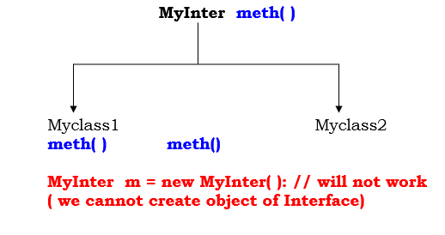
Interfaces:
Interface:
DMD Using Interfaces:
MyInter m ; (We can create object reference variable of Interface)
m= new Myclass1( );
m.meth( );// meth( ) of Myclass1
m= new Myclass2( );
m.meth( );//meth( ) of Myclass2

Slide 16
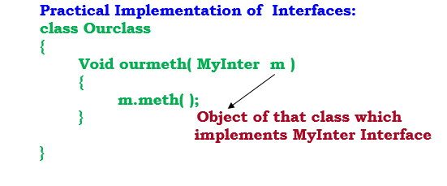
Interfaces:
Interface:
DMD Using Interfaces:
Code-15:

Slide 17
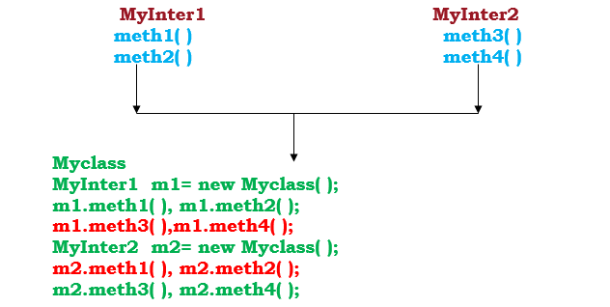
Interfaces:
Multiple Inheritance using Interfaces:
A class can implements multiple interface. But in that class it should provide bodies to all methods of implemented interface, otherwise that class should be declared as an abstract class. This is how Java provides multiple inheritance.
Code-16:

Slide 18
Interfaces:
Interfaces can be extended: We can inherit one interface to another interface.
Code-17:
MyInter1- meth1()
extends
MyInter2- meth2()
MyClass implements MyInter2
Variable in Interfaces: The variables in Interface are implicitly static and final.
Code-18:

Slide 19
Interfaces:
Difference between Abstract class and Interface.
Abstract classes are used only when there is a “is-a” type of relationship between the classes. Whereas Interfaces can be implemented by classes that are not related to one another.
We cannot extend more than one abstract class. We can implement more than one interface.
Methods of a Java interface are implicitly abstract and cannot have implementations. A Java abstract class can have instance methods that implements a default behavior.
Variables declared in a Java interface is by default final. A Java abstract class may contain non-final variables.
Members of a Java interface are public by default. A Java abstract class can have the usual flavors of class members like private, protected, etc.

Slide 20
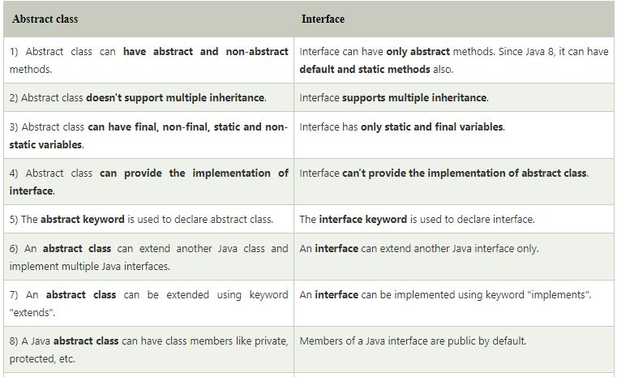
Interfaces:
Difference between Abstract class and Interface.

